Slide 1

ADW Enhanced Generative
Integrated Scheduler
Planner Guide

Slide 2
Table of Content
Switching to Planner view
Schedules module
Creating a new draft schedule
Publishing a schedule
Editing a published schedule
Requests module
Create new requests / View submitted requests
Edit/Delete requests

Slide 3
Table of Content
Members module
Adding a new member
Changing members’ qualification
Roles module
Adding a new role
Switching back to Member view

Slide 4
Switching to Planner View

Slide 5
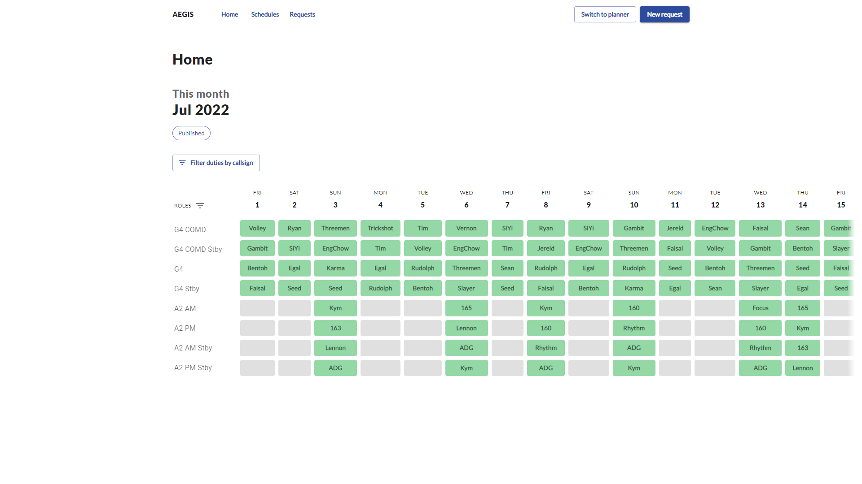
Click to access planner page
The default home page is the member’s view with the published schedule of the current month (if applicable)

Slide 6
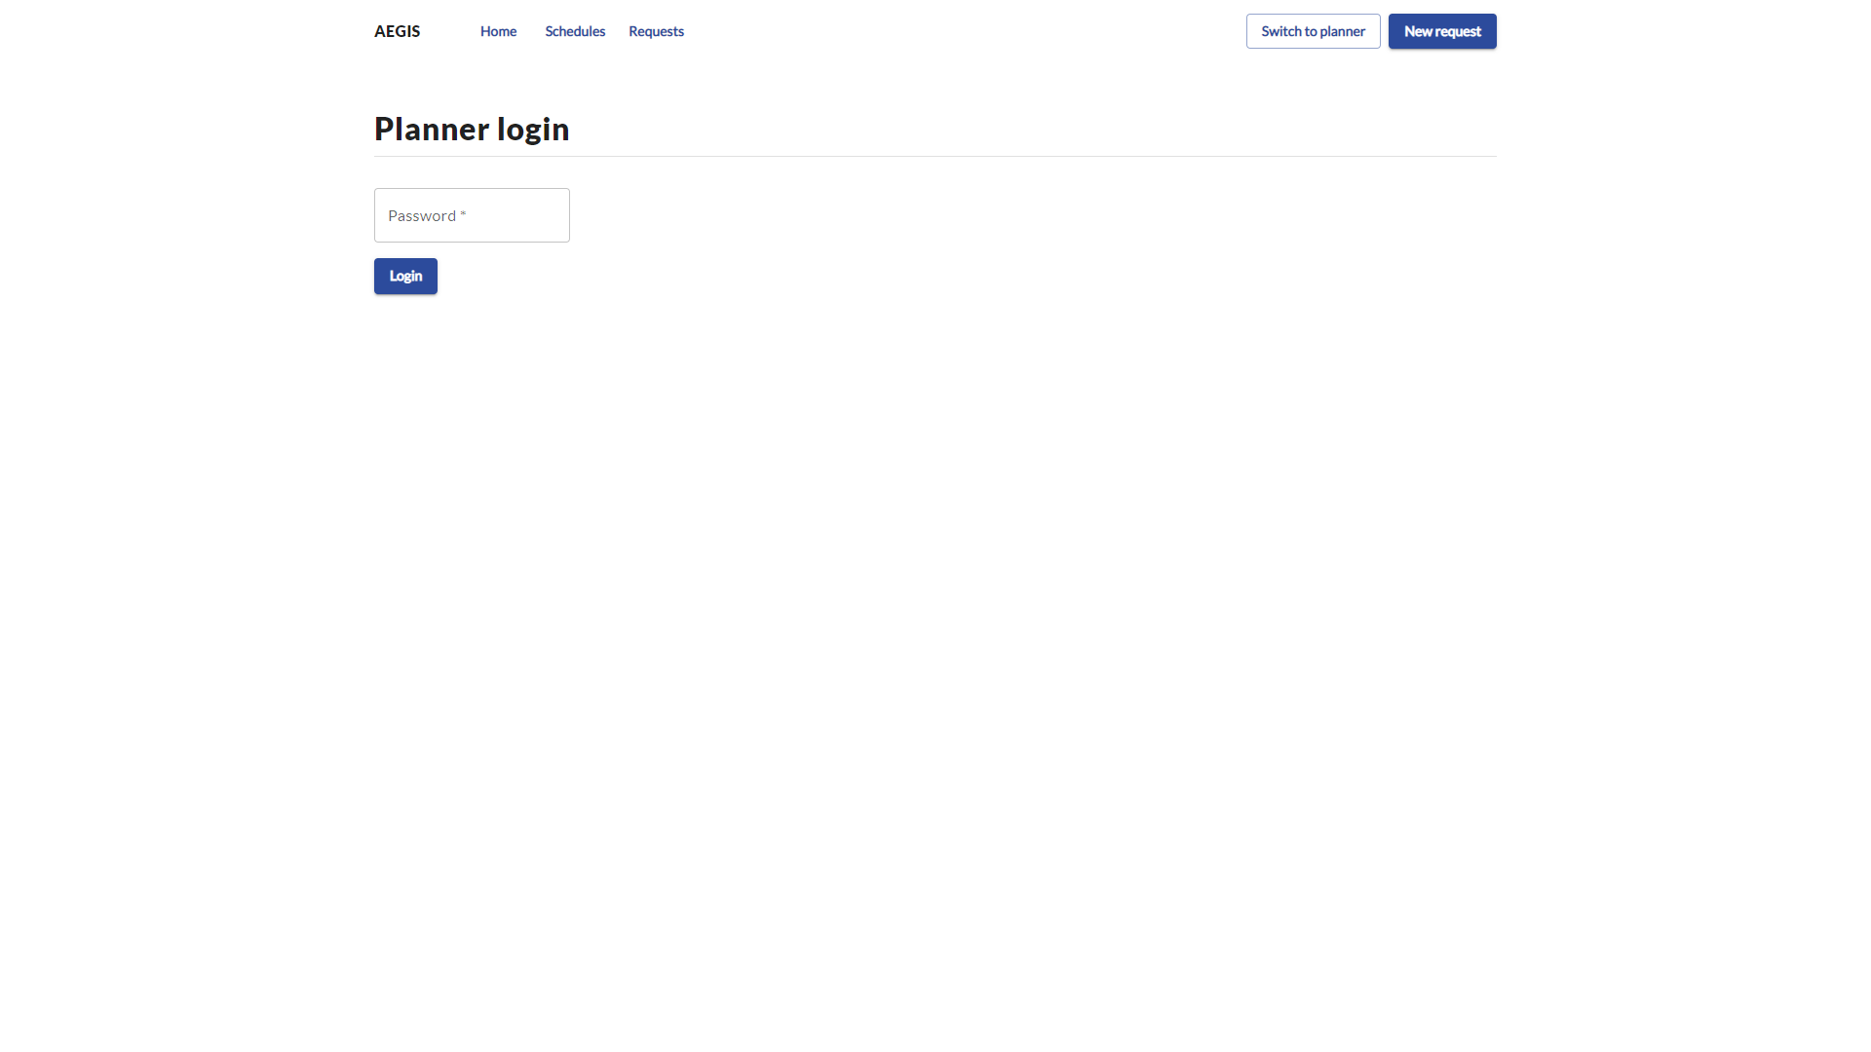
Enter password

Slide 7
Schedules module
Creating a draft schedule

Slide 8
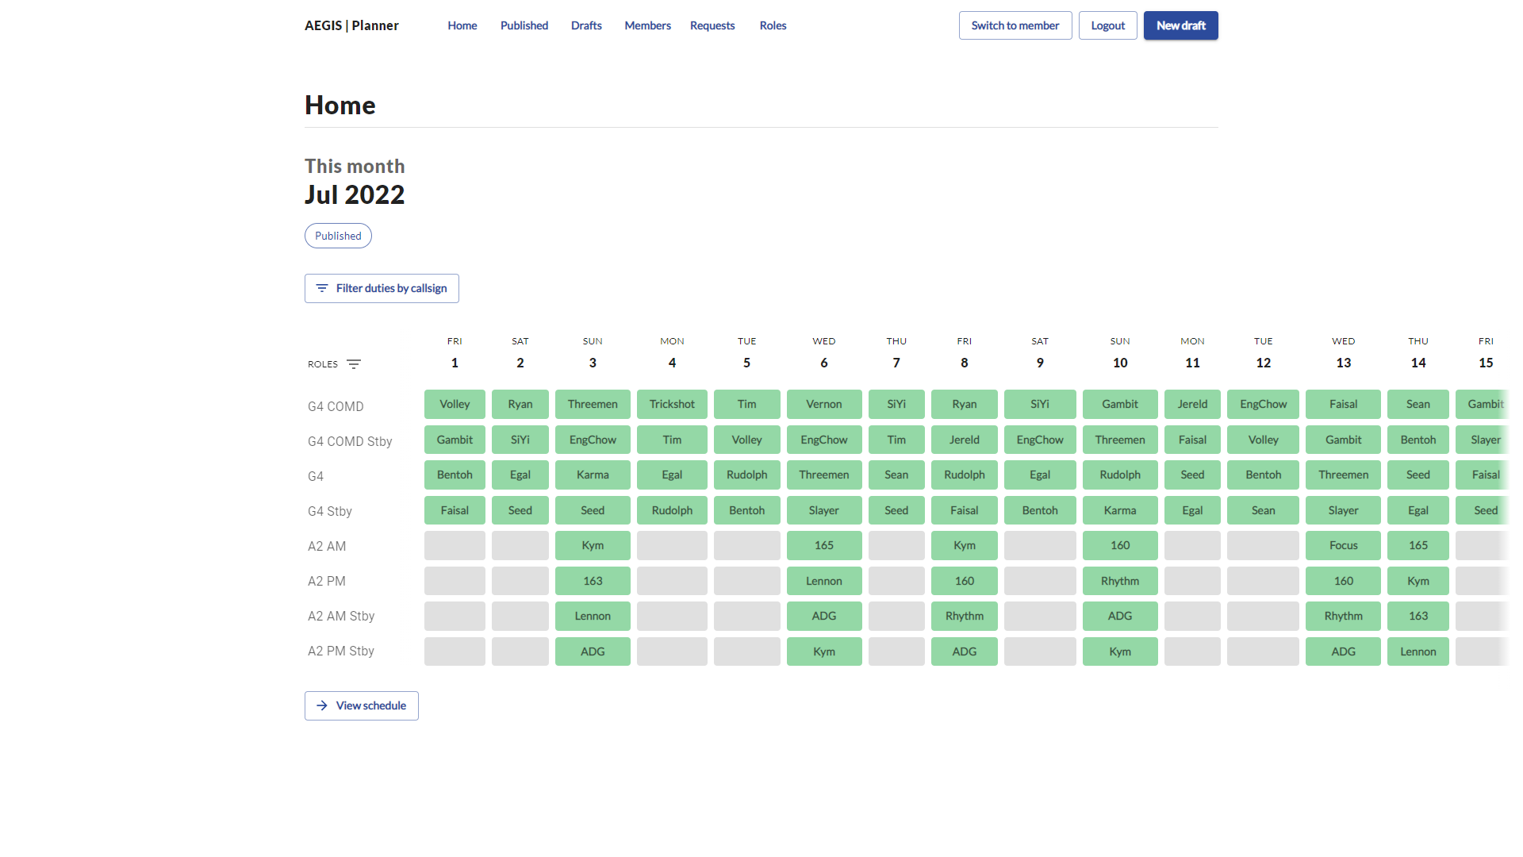
Click to create new draft

Slide 9
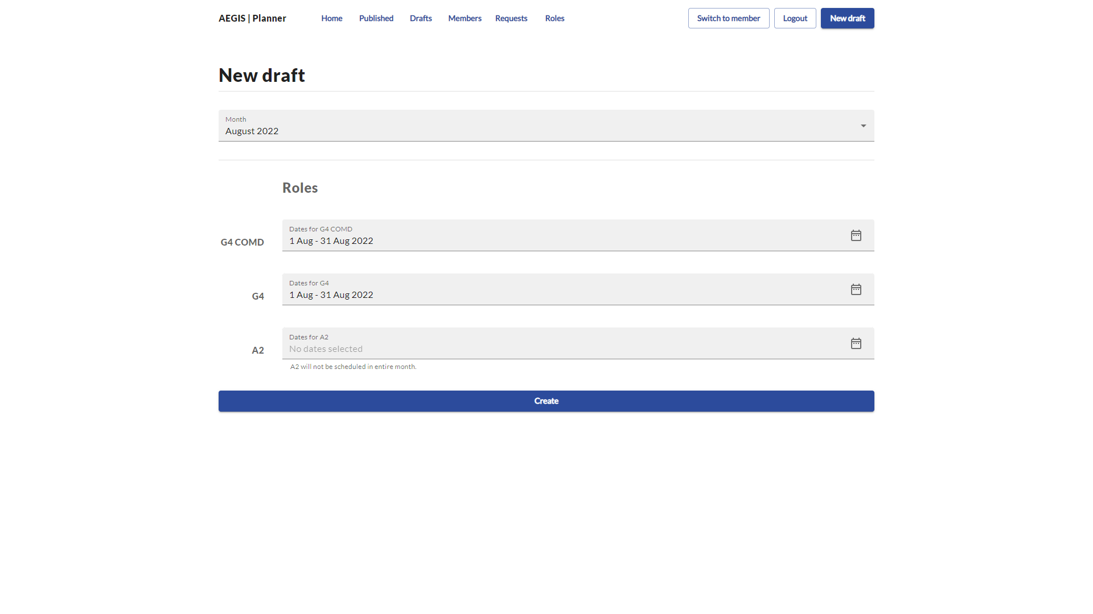
Select dates here
All dates are selected by default except for `A2`

Slide 10
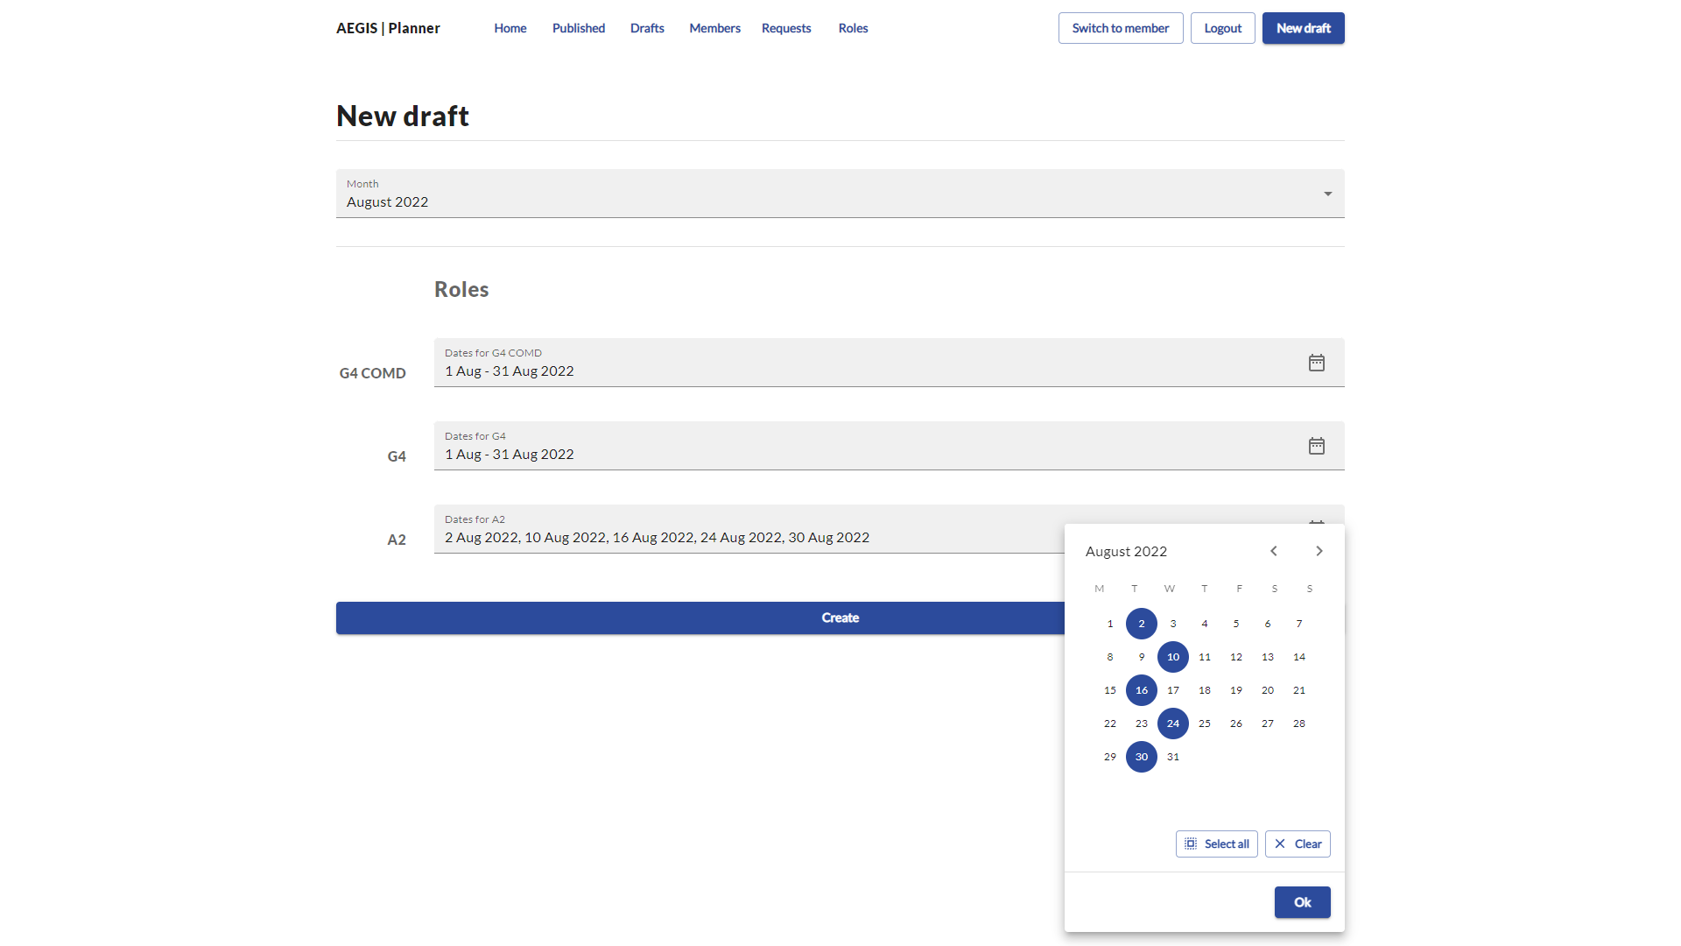
Click ‘Ok’ after selecting the dates which your sqn has to perform the A2 duty

Slide 11

Click ‘Create’

Slide 12
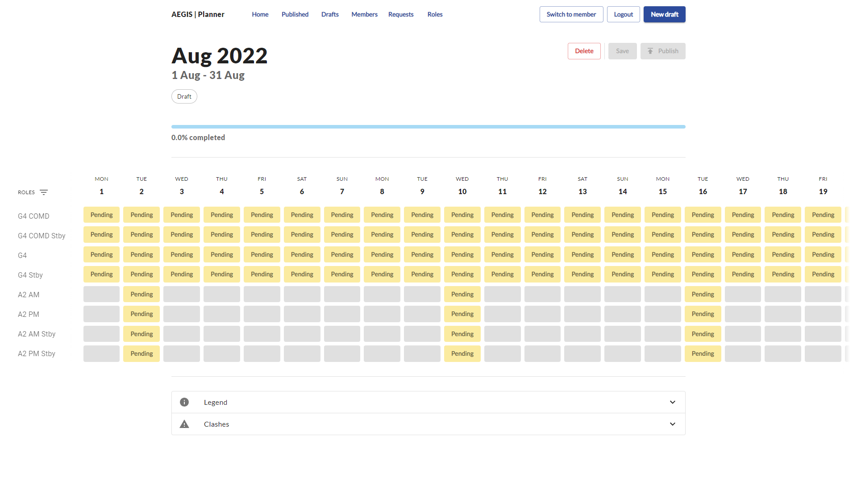
Click on individual ‘pending’ boxes to select personnel to plan for the role
Click to delete current draft

Slide 13
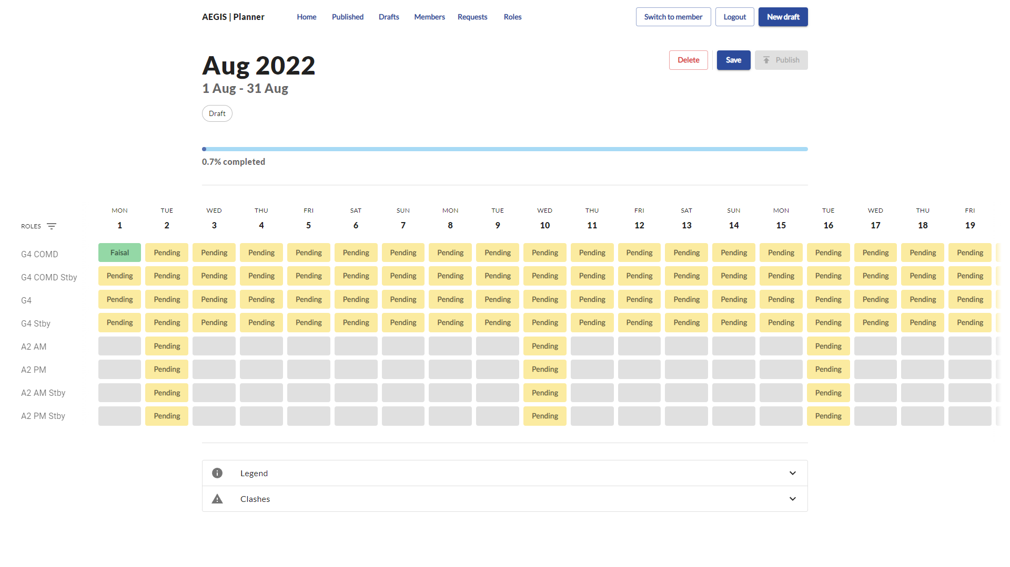
Access current drafts (there can only be one draft for each unique month)
Save current draft
Visual cue to know if all roles are planned

Slide 14
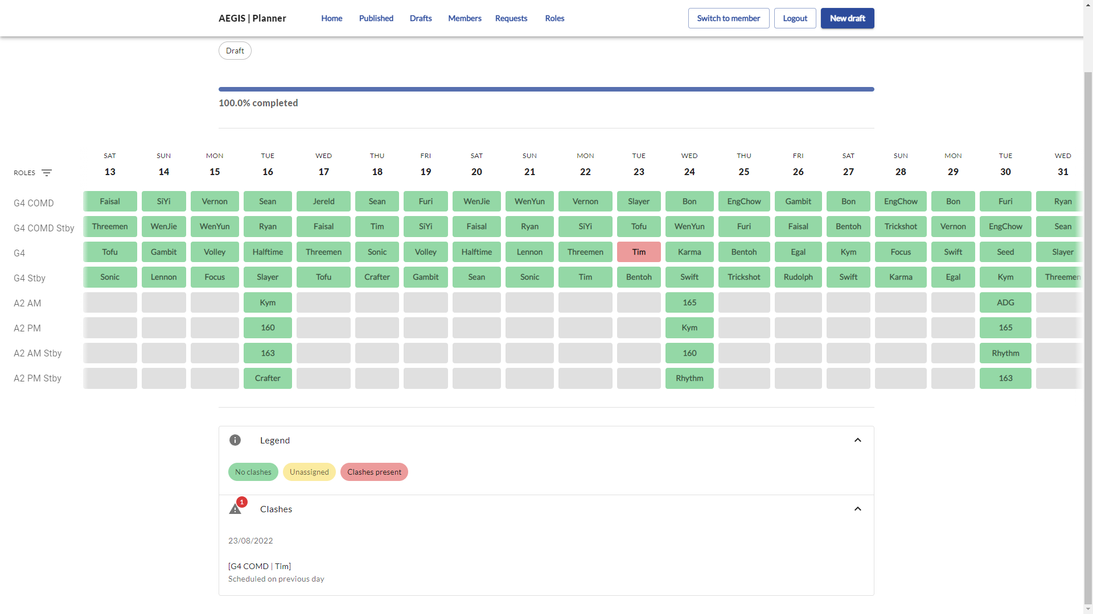
Clashes are shown in red and summarized in the text box below

Slide 15
Clashes are shown in red and summarized in the text box below

Slide 16
Schedules module
Publishing a schedule

Slide 17
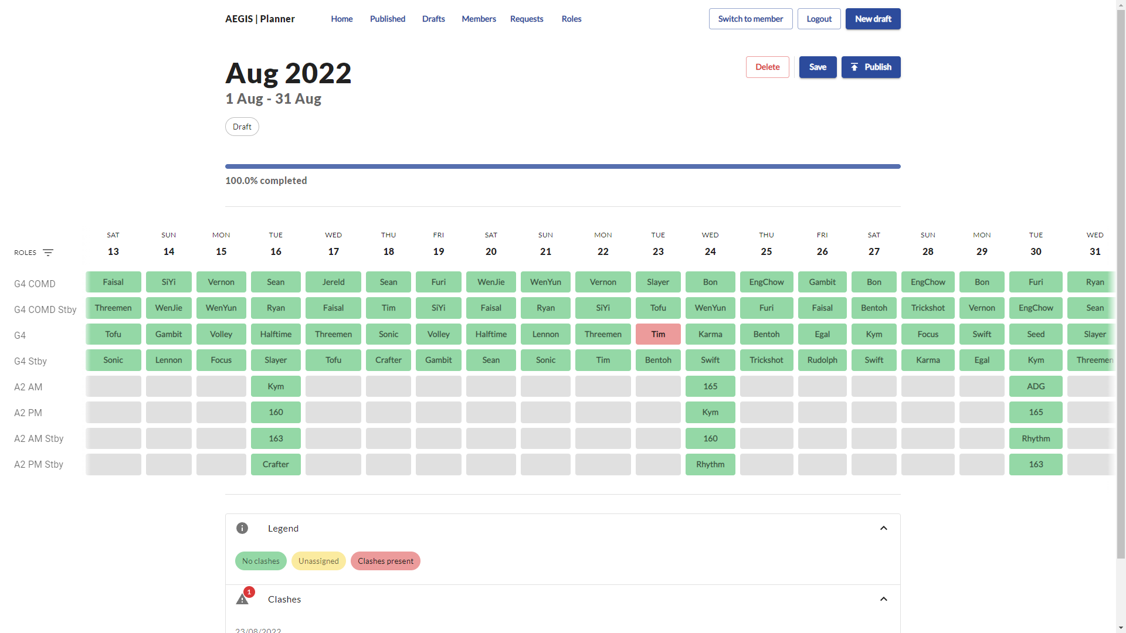
Draft can only be published when all roles are filled
Access all published schedules

Slide 18
Schedules module
Editing a published schedule

Slide 19
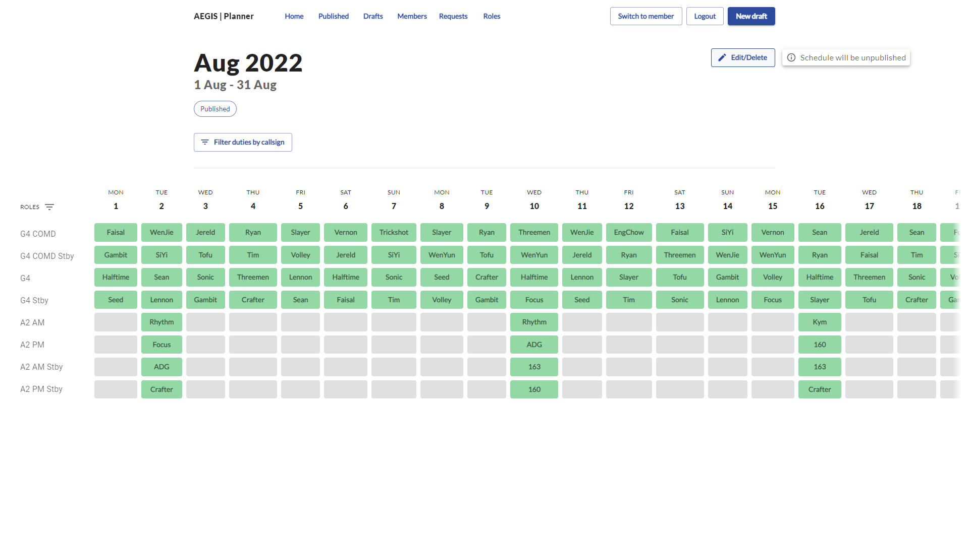
Click to unpublish the schedule into a draft
Clashes will not show up in a published schedule
A published schedule can only be edited by unpublishing it, and editing it as a draft thereafter

Slide 20
Requests module
Create new requests / View submitted requests

Slide 21
Click to access requests

Slide 22
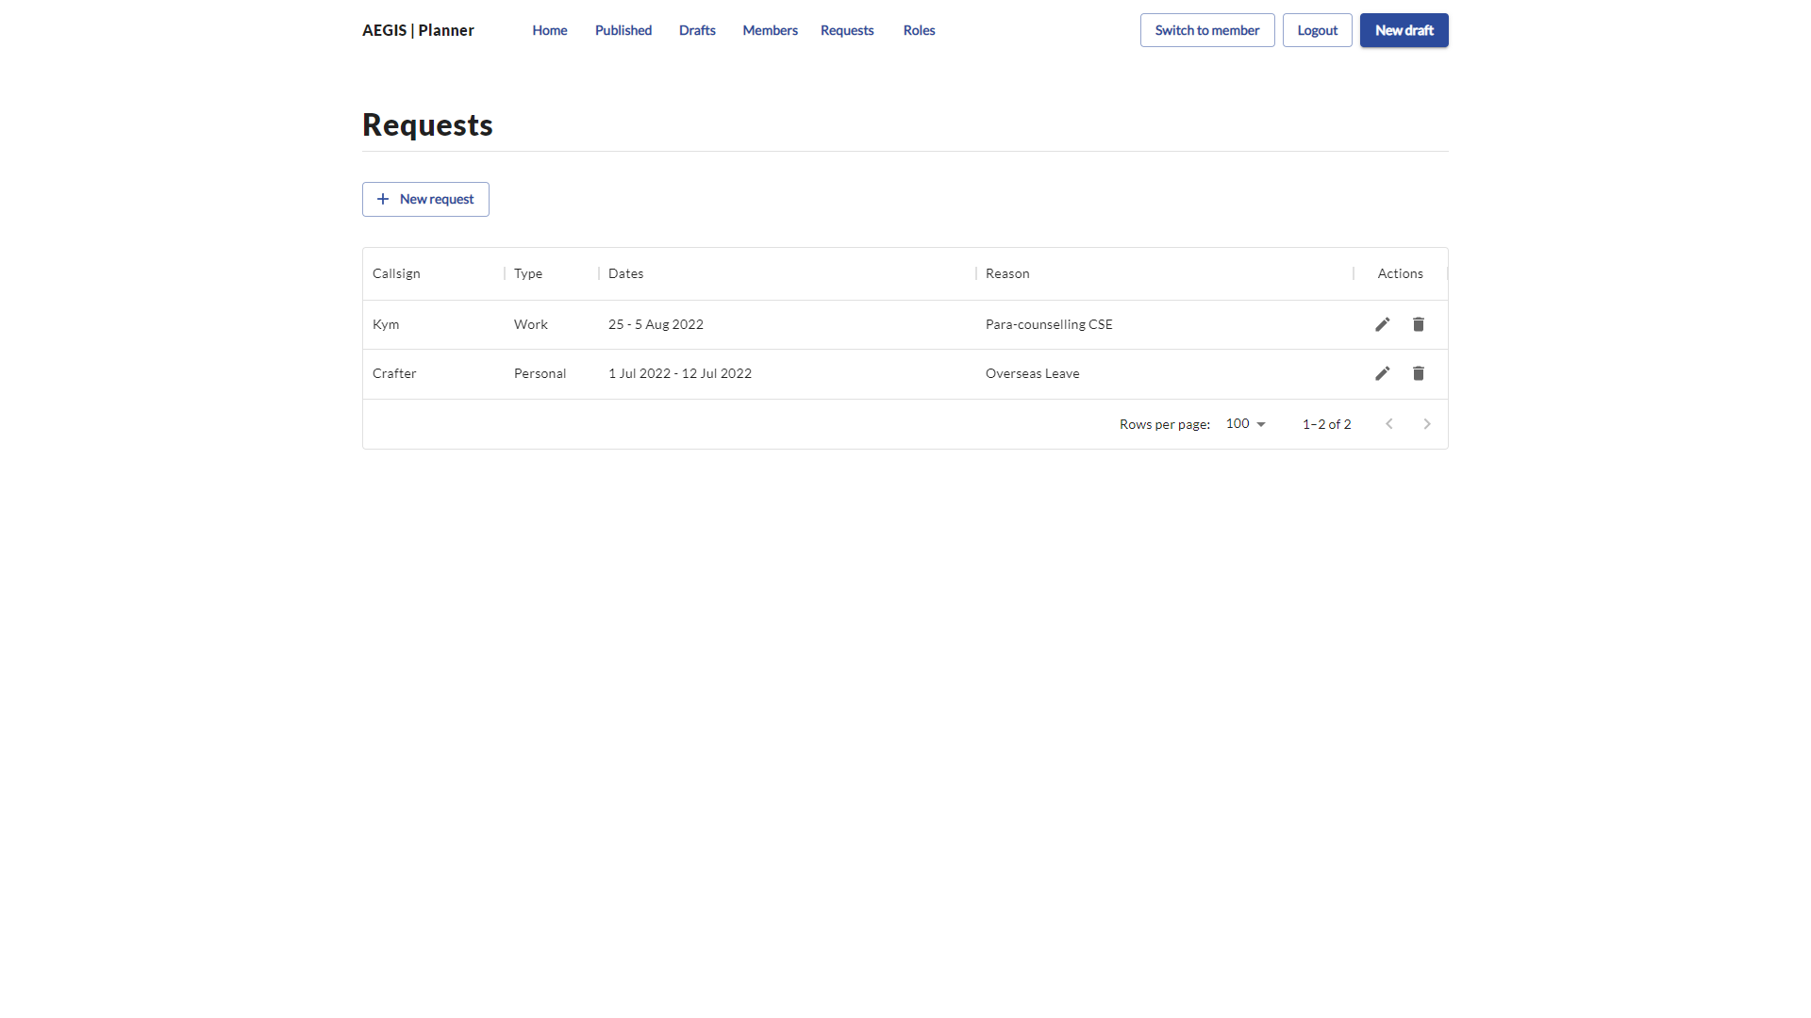
Click to create new requests

Slide 23
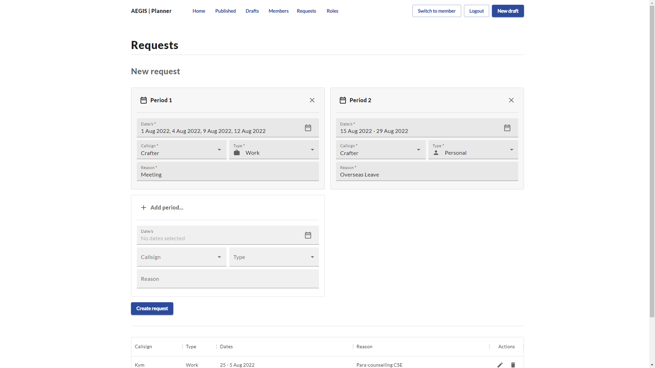
Click to create requests
Create multiple requests

Slide 24
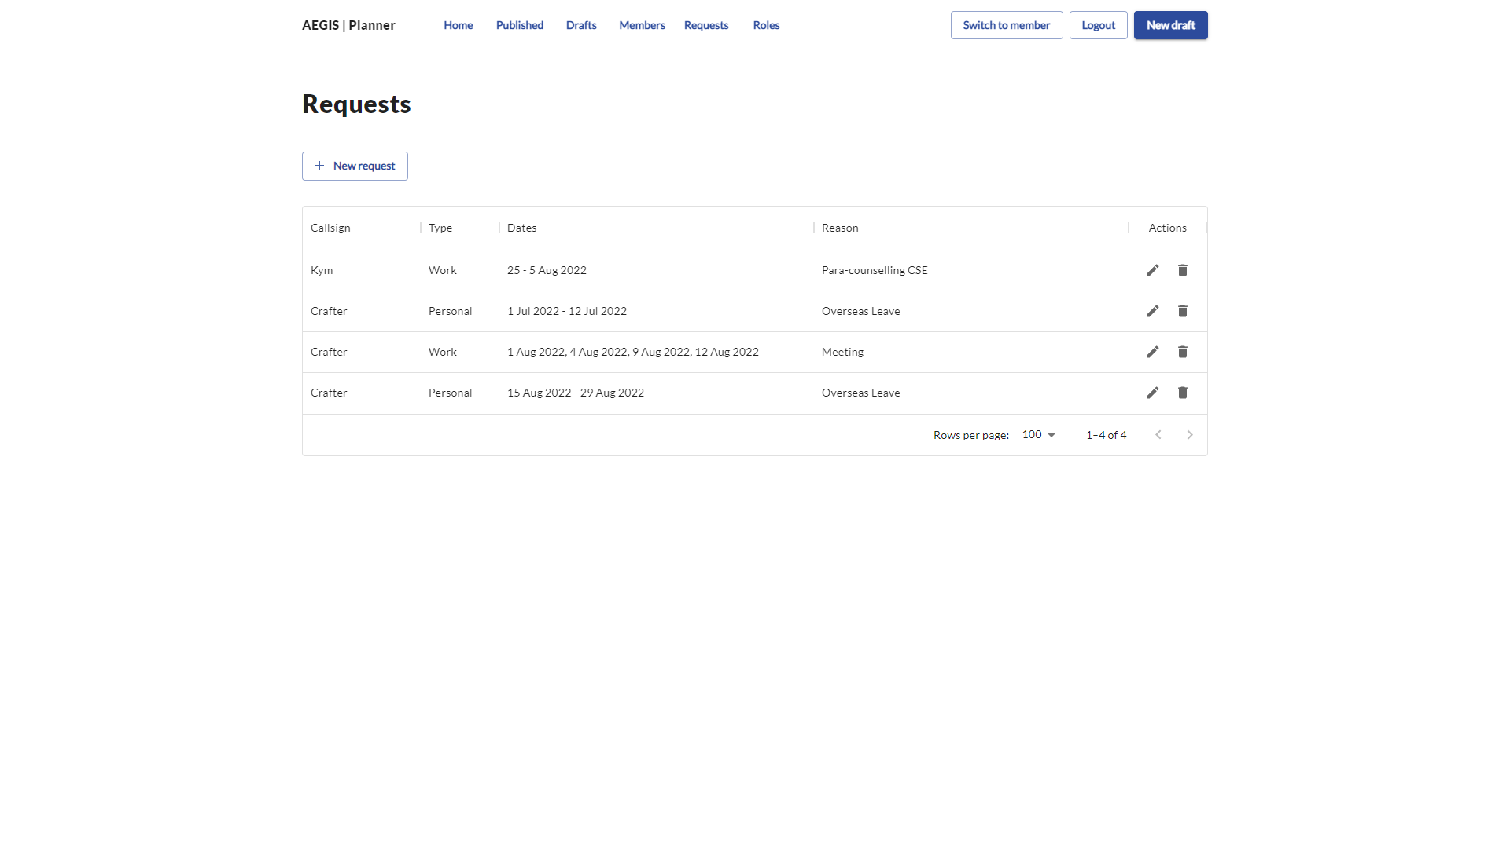
Requests are automatically updated upon creation

Slide 25
Requests module
Edit/Delete requests

Slide 26
Edit request
Delete request

Slide 27
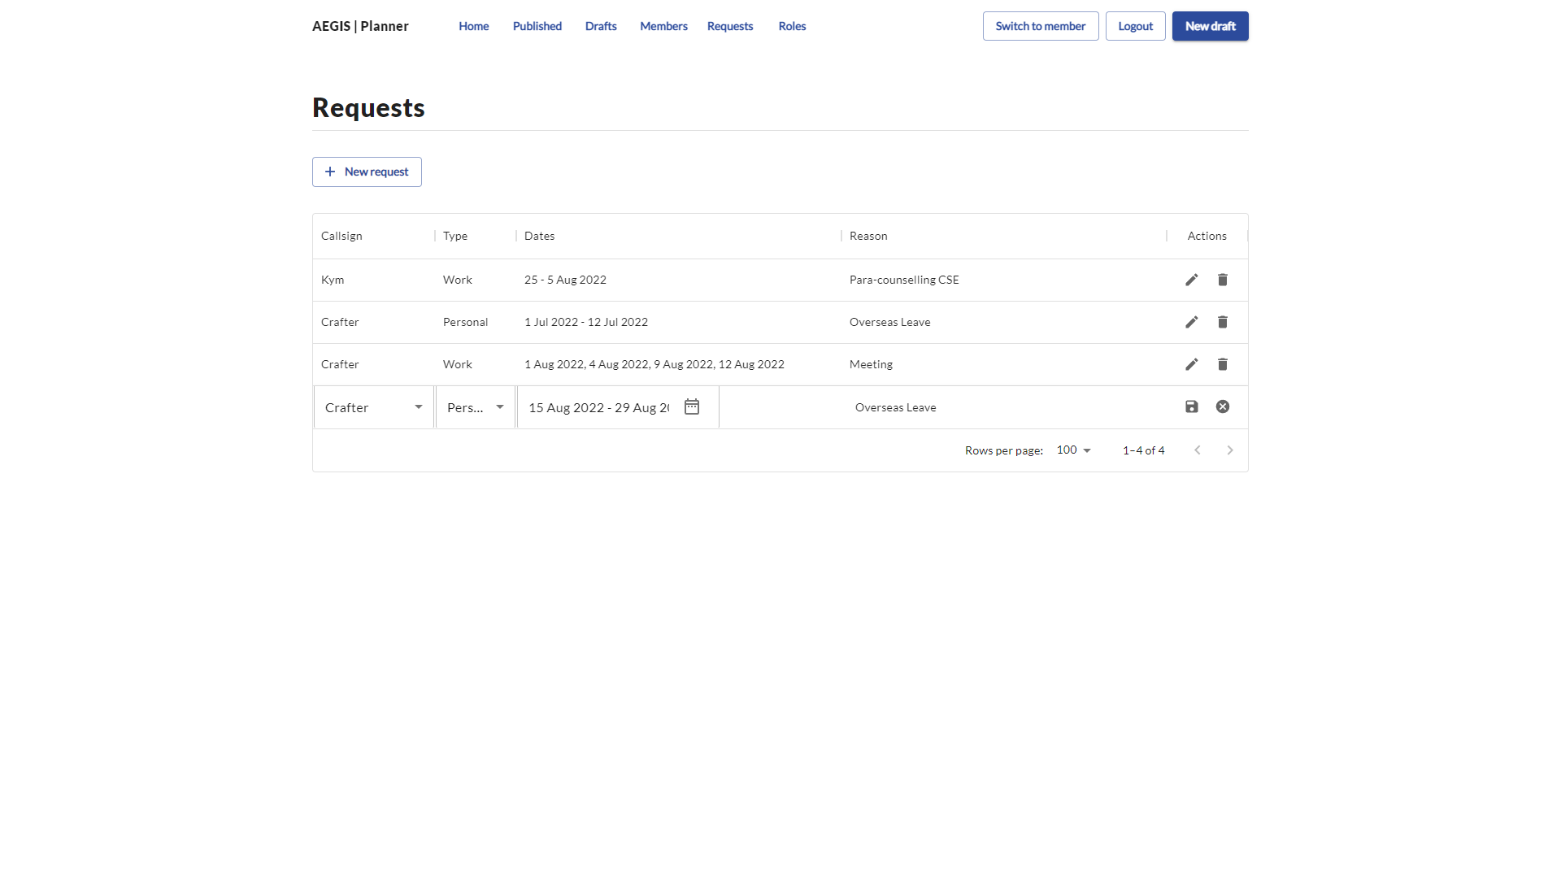
Cancel edits
Callsign, Type, Dates, Reasons are editable
Click to save edits

Slide 28
Members module
Adding a new member

Slide 29
Click to access list of all members in the sqn

Slide 30
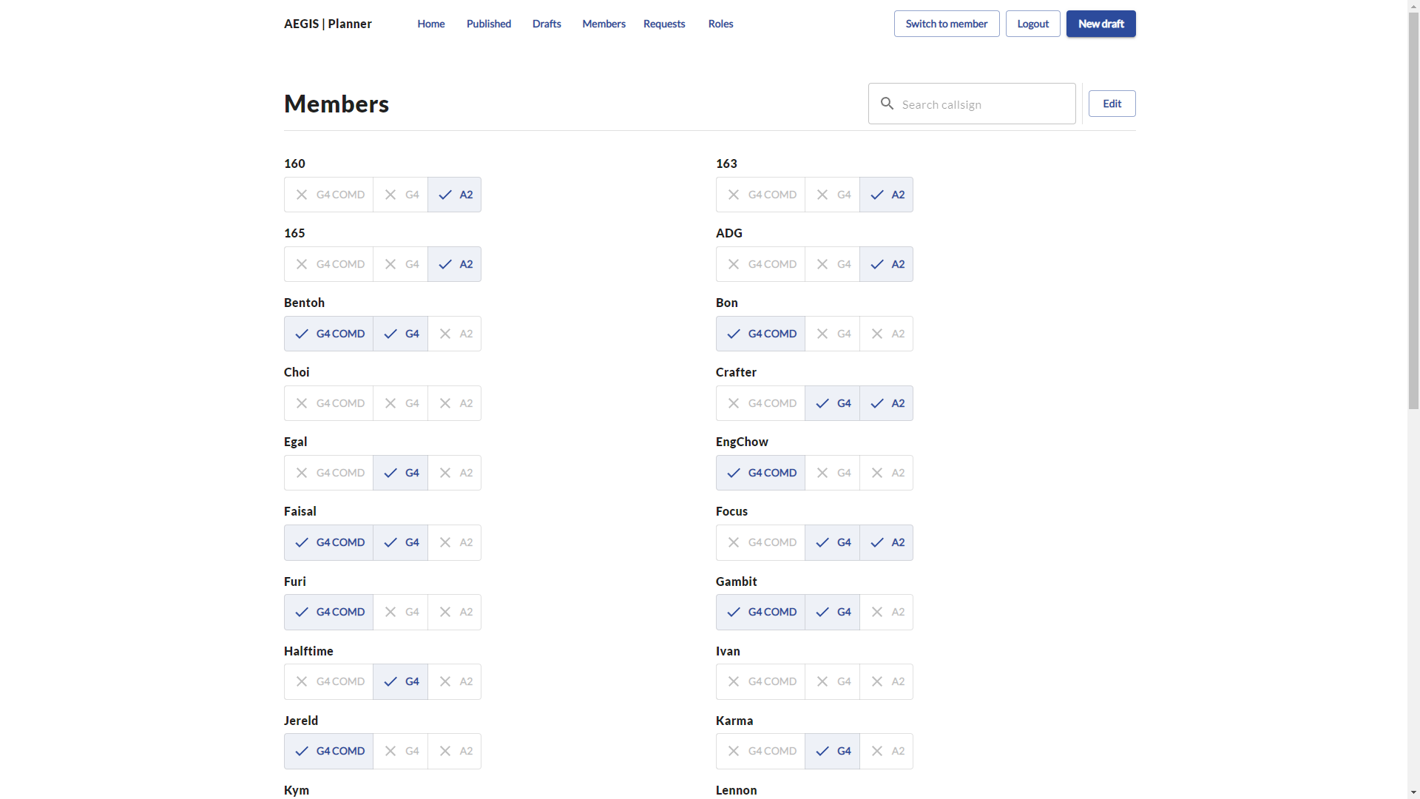
Click to edit members
Search for member

Slide 31
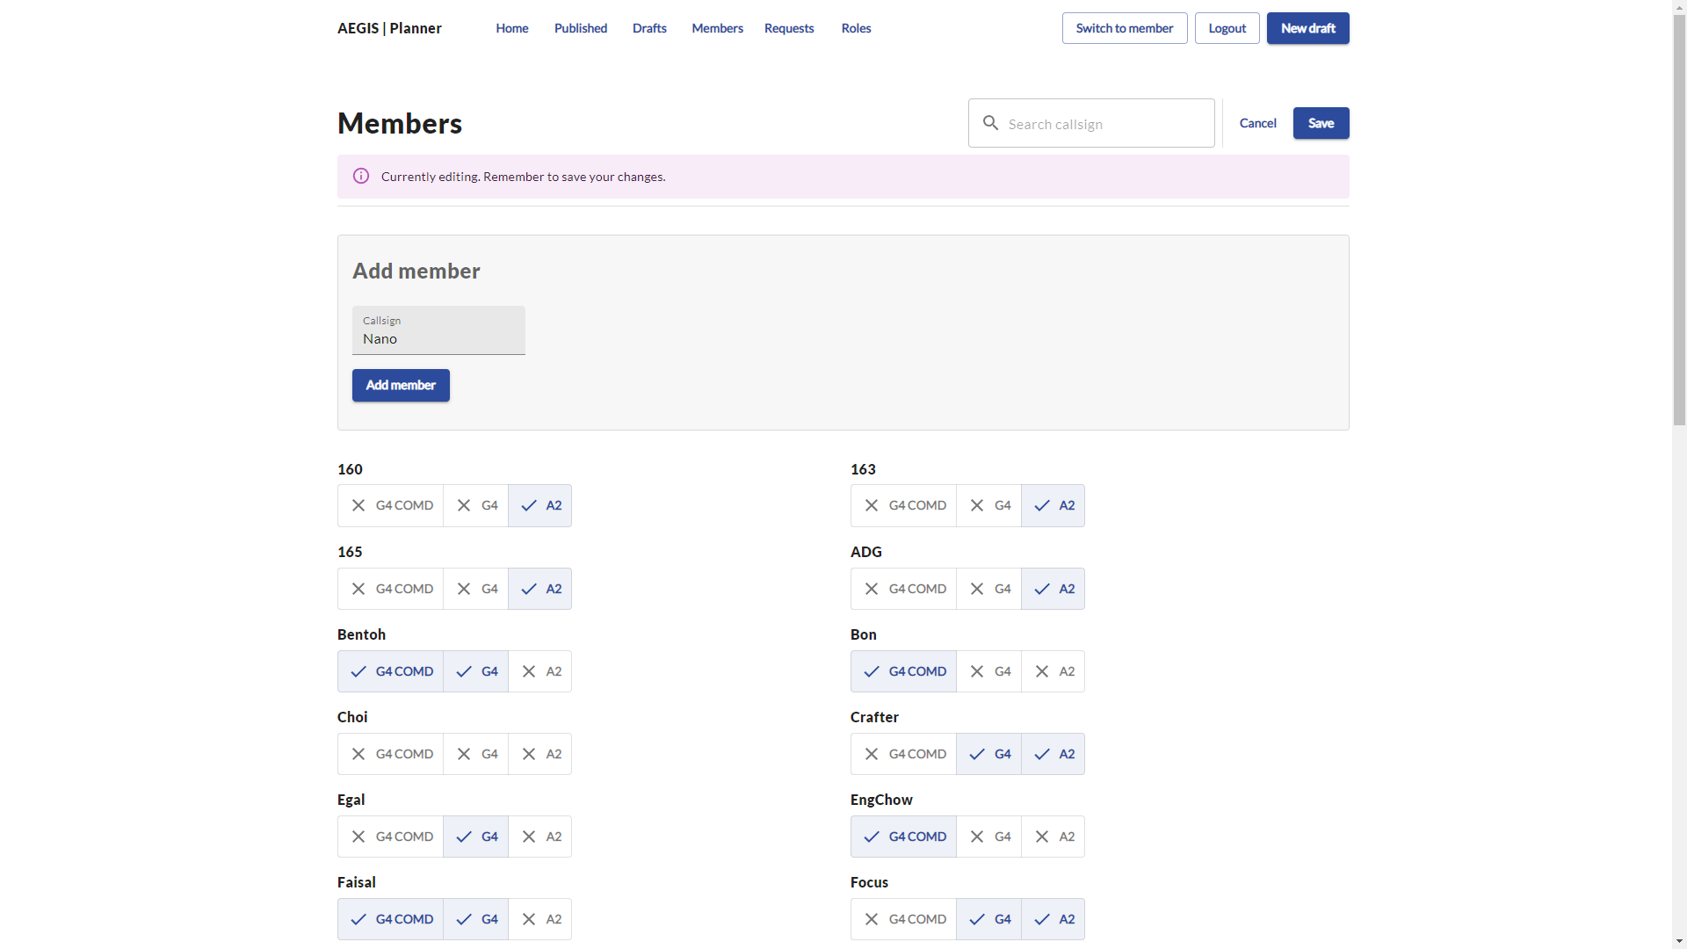
Click add member after filling in callsign
Search for member

Slide 32
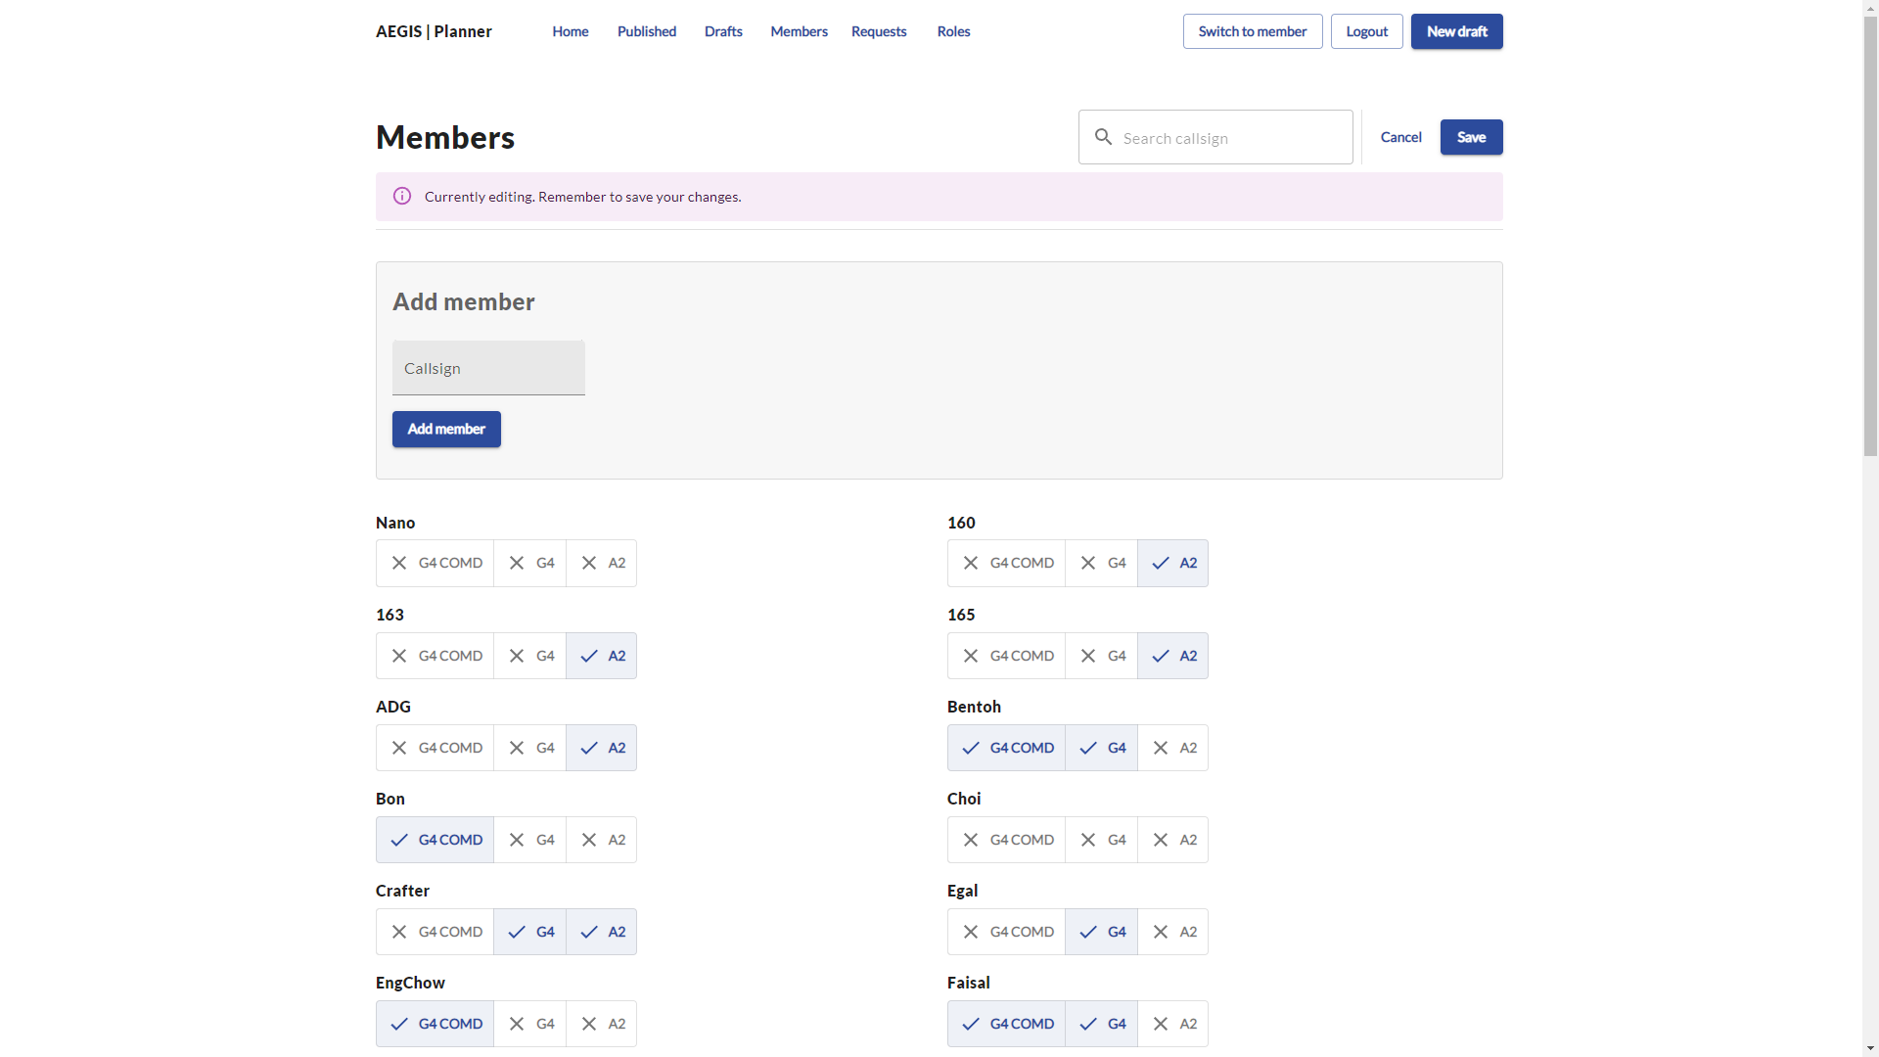
Save changes
Search for member
A new member with no qualifications is created

Slide 33
Members module
Changing members’ qualification

Slide 34
Click to edit members

Slide 35

Save changes
Check/uncheck the relevant qualifications

Slide 36
Roles module
Adding a new role

Slide 37

Click to access roles page

Slide 38
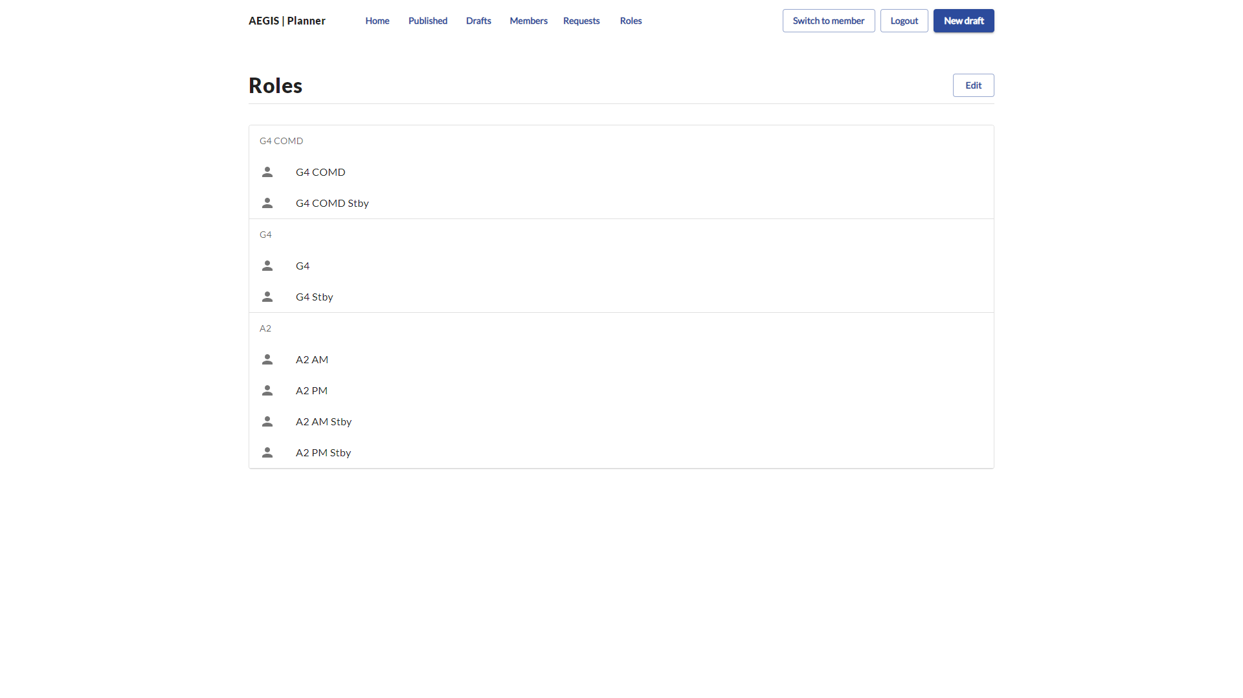
Click to edit
In the unlikely event that new roles have to be added, they can be done through this page

Slide 39
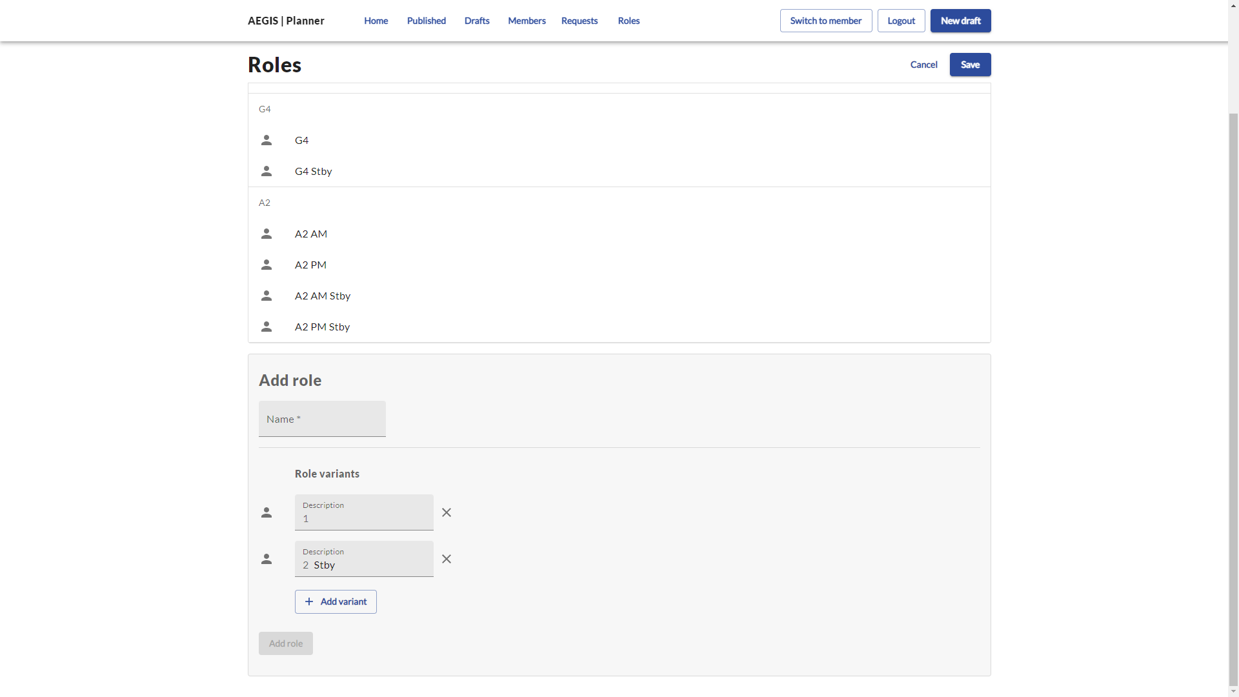
Save changes
Name of new role
Variants refer to ‘main’, ‘stby’, ‘AM’, ‘PM’ etc
Leave blank for ‘main’
Add when completed

Slide 40
Switching back to Member view

Slide 41
Click to access member page

